Slide 1
MITM using Rogue Wireless AP
Keshaw Kumar Burnwal

Slide 2
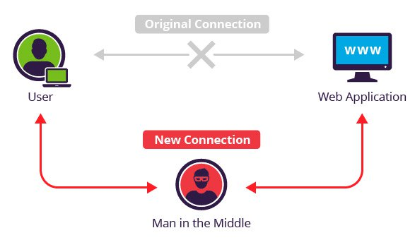
What is MITM
Man In The Middle (MITM)
Attacker positions himself between client and server
Eavesdrop communication or impersonate one of the parties.
Notes:
Eavesdropping communication is passive & impersonating is active MITM

Slide 3
MITM (Cont.)
Active MITM is two stage process.
Interception
ARP Spoofing
DNS Spoofing
IP Spoofing
Rogue on-the-path device
Decryption
SSL Hijacking
SSL Stripping
HTTPS Spoofing

Slide 4
Existing Prevention
Hyper Text Transfer Protocol Secure (HTTPS)
HTTP Strict Transport Security (HSTS)
Use Virtual Private Network (VPN )
Cautious use of Public Wi-Fi

Slide 5
Are these enough?

Slide 6
Threat Model
Attacker can install malicious Root-CA or Intermediate CA (I-CA) in root store of victim
Shared computers
Compromise a valid CA (Stuxnet, DigiNotar)
Attacker can place his machine in between victim and server.

Slide 7
SSLSplit
Written by Daniel Roethlisberger
Bypass
server-instructed public key pinning (HPKP),
strict transport security restrictions (HSTS),
Certificate Transparency enforcement (Expect-CT)
OCSP based certificate check
Supports
plain TCP, plain SSL, HTTP and HTTPS
IPv4 and IPv6
Encryption: RSA, DSA and ECDSA keys and DHE and ECDHE cipher suites.
Server Name Indication (SNI)
SSL 3.0, TLS 1.0, TLS 1.1 and TLS 1.2, and optionally SSL 2.0 as well.

Slide 8
SSLSplit(Cont.)
Using NAT Engine to terminate connections transparently.
Terminates existing SSL/TLS and initiates a new SSL/TLS connection to the original destination address, while logging all data transmitted.
Generates and signs forged X509v3 certificates on-the-fly, mimicking the original server certificate’s subject DN, subjectAltName extension and other characteristics.

Slide 9
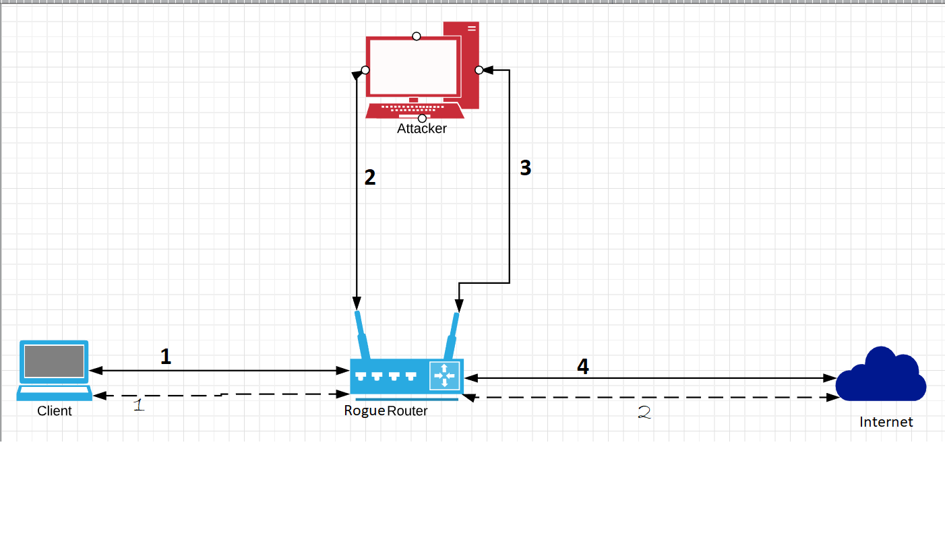
Lab Setup

Slide 10
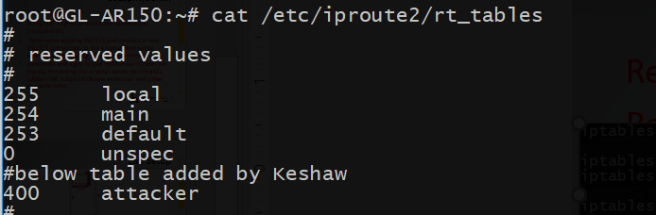
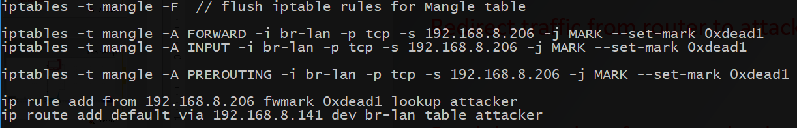
Lab Setup (Cont.)
Redirect traffic from router to attacker.
Send data packets from attacker back to router

Slide 11
Setup (Cont.)
Create X509 certificate
Create NAT rules
Start SSLSplit

Slide 12
DEMO
MITM on Amazon.com

Slide 13
Some More Examples

Slide 14
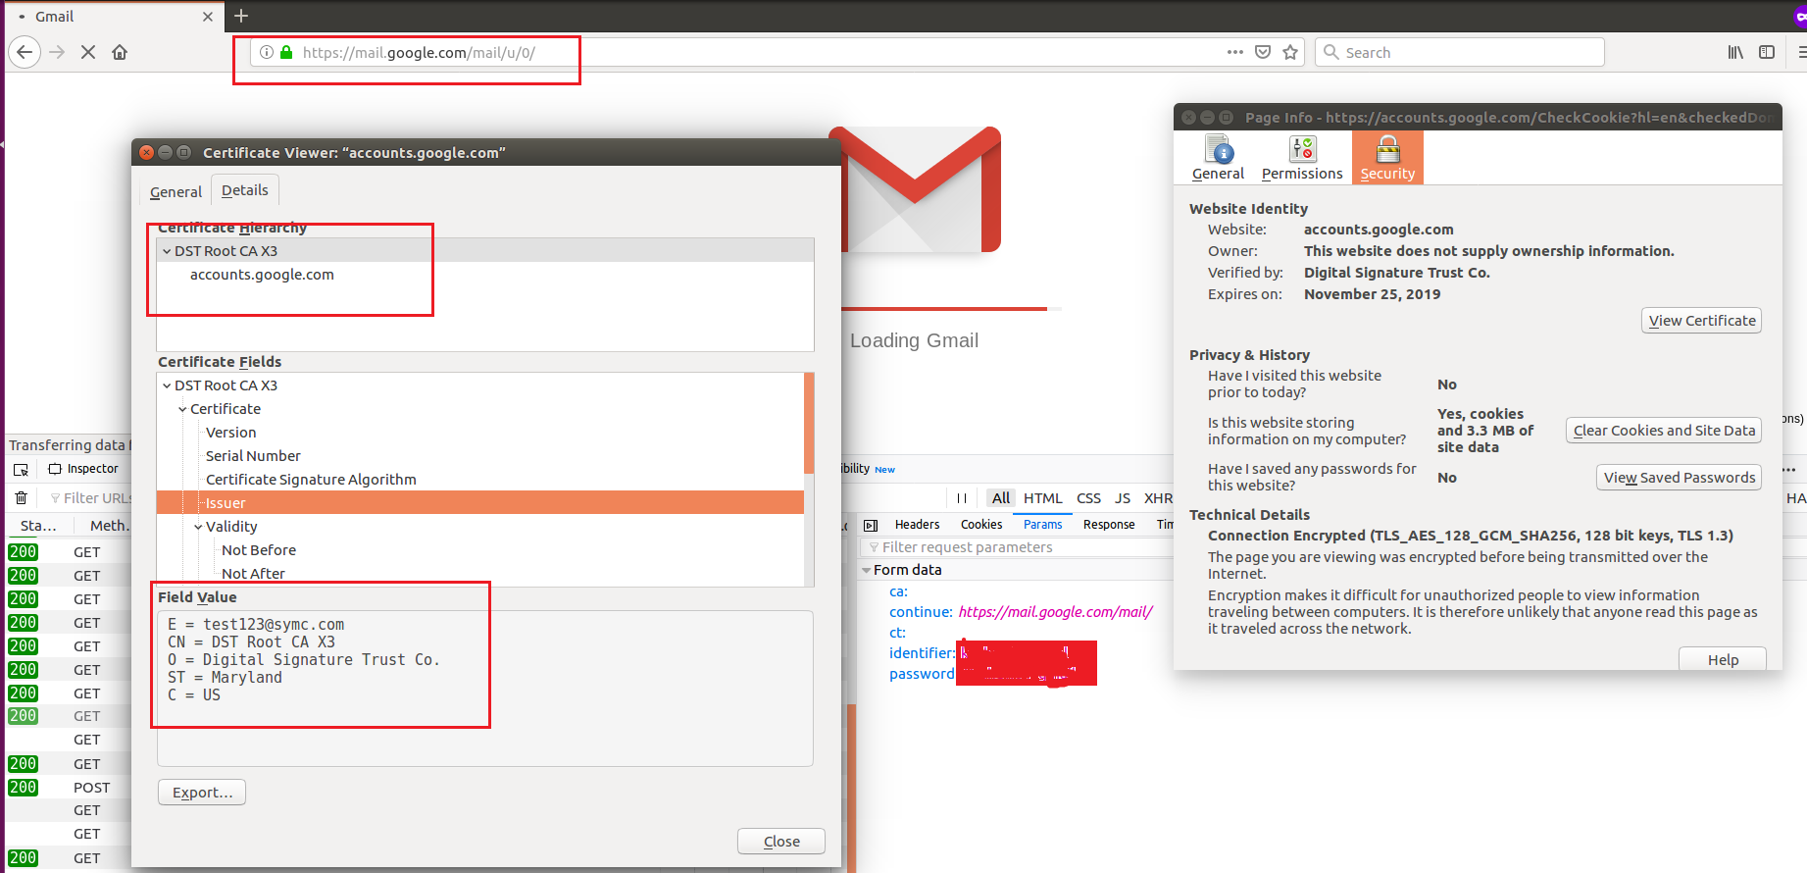
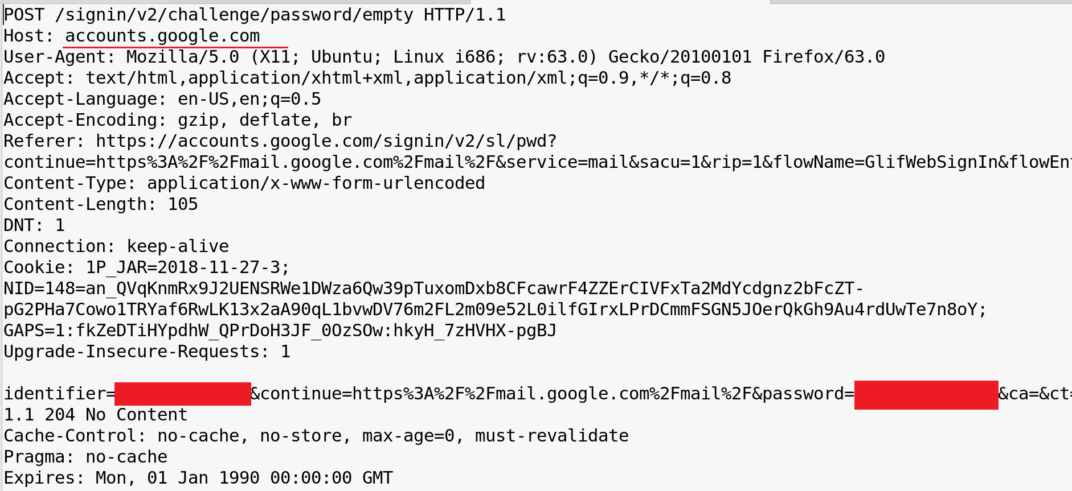
HSTS Bypassed

Slide 15
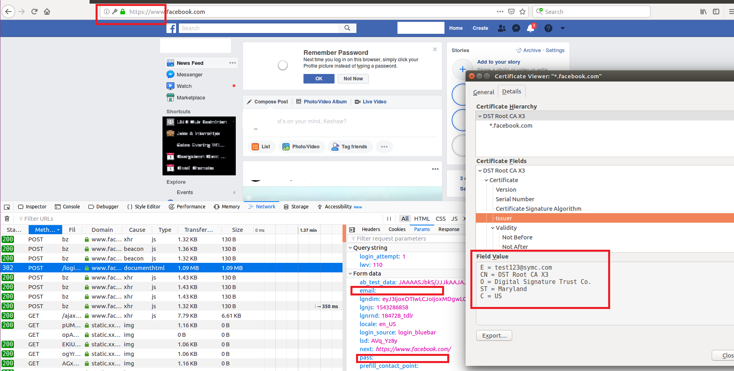
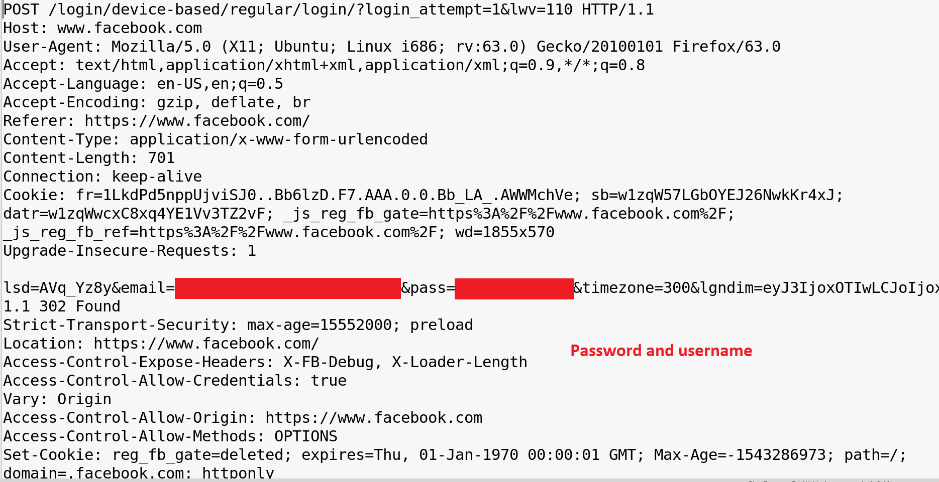
Intercepting Facebook

Slide 16
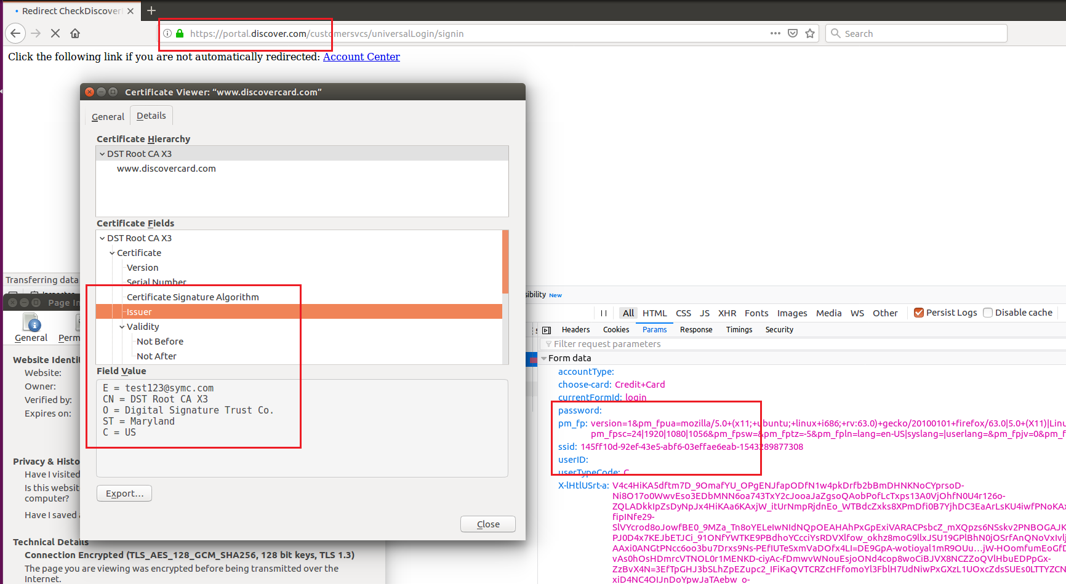
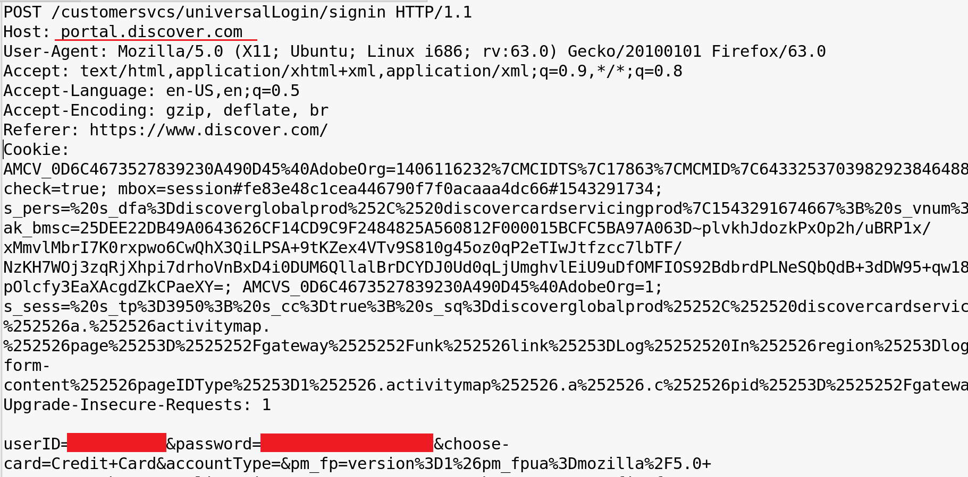
Intercepting Financial Transaction

Slide 17
Prevention
Don’t send critical information in plain text
Use VPN
Hard-coded configuration based HSTS implementation

Slide 18


